Slide 1
Digital Portfolio
STUDENT NAME: S.SHARMILA
REGISTER NO AND NMID: 36324U18061
DEPARTMENT: BSC (computer science)
COLLEGE: COLLEGE/ UNIVERSITY:Sree Abiraami Arts and Science College for women , Gudiyatham
From Thiruvallur University

Slide 2
PROJECT TITLE
Digital portfolio front end web development

Slide 3


AGENDA
Problem Statement
Project Overview
End Users
Tools and Technologies
Portfolio design and Layout
Features and Functionality
Results and Screenshots
Conclusion
Github Link
3/21/2024 Annual Review

Slide 4

PROBLEM STATEMENT
A problem statement defines the issue that needs to be addressed, providing clarity on the gap between the current situation and the desired outcome. It highlights the significance of the problem, its impact, and why it requires a solution. A well-written problem statement guides research or projects by setting focus, identifying challenges, and establishing the purpose for finding effective solutions.

Slide 5

PROJECT OVERVIEW
A project overview provides a clear summary of the project’s purpose, objectives, and scope. It outlines the main idea, goals, and expected outcomes while highlighting its importance and benefits. The overview also gives insight into the project’s approach, resources, and timeline. It serves as an introduction, helping stakeholders understand the vision, direction, and overall significance of the project.

Slide 6

WHO ARE THE END USERS?
End users are the individuals or groups who directly use a product, system, or service to fulfill their needs. They are the final consumers who interact with the application or solution after it has been developed and delivered. Unlike developers or administrators, end users focus on utilizing the features rather than understanding technical aspects. Their feedback plays a vital role in improving performance, usability, and effectiveness. Ultimately, end users determine the success and acceptance of any product or service.

Slide 7

TOOLS AND TECHNIQUES
Tools and techniques are essential resources used to complete tasks effectively and efficiently in any project or field. Tools can be physical devices, software applications, or frameworks that assist in achieving objectives, while techniques are the methods or processes applied to solve problems and improve outcomes. Together, they enhance productivity, accuracy, and quality of work.

Slide 8
POTFOLIO DESIGN AND LAYOUT
A portfolio design and layout should be simple, modern, and visually appealing. It should begin with a clean homepage featuring the user’s name, photo, and a brief introduction. Sections must include About Me, Skills, Projects, Resume, and Contact details. Each project should display images, descriptions, and links. A consistent color theme, readable fonts, and white space improve clarity. Navigation should be smooth and user-friendly. Responsive design ensures accessibility on all devices, making the portfolio professional and impactful for viewers.
8

Slide 9
FEATURES AND FUNCTIONALITY
Features and functionality define the core value of any product, system, or application. Features refer to the visible attributes, tools, or services offered, while functionality explains how effectively these features perform to meet user needs. Together, they ensure usability, efficiency, and satisfaction. Well-designed features with smooth functionality improve user experience and reliability. They also help in solving problems, automating tasks, and achieving goals. Continuous updates and enhancements in features and functionality contribute to long-term success and user engagement.

Slide 10


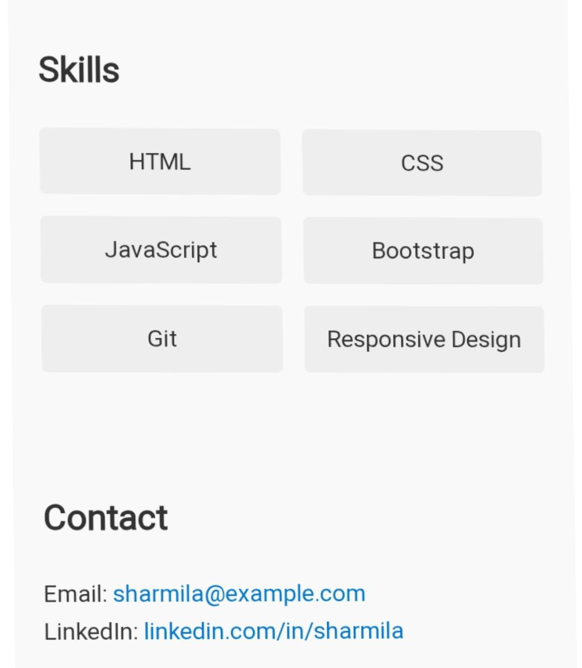
RESULTS AND SCREENSHOTS
3/21/2024 Annual Review
10

Slide 11
GitHub Link
https://sharmilasathish149.github.io/sharmiportfolio/

Slide 12
CONCLUSION
In conclusion, every project or product achieves success through clear objectives, effective tools, and user-focused design. Understanding end users, applying the right techniques, and ensuring strong features with smooth functionality are essential. A well-structured portfolio highlights these efforts professionally. Continuous improvement and innovation ensure growth, making the overall outcome impactful, reliable, and beneficial for long-term success.
12

